Slide 1

EchoVerse: AI-Powered Audiobook Creation
EchoVerse is a generative AI-based audiobook creation system that transforms user-provided text into expressive, downloadable audio content. Designed for accessibility, convenience, and content reusability, the tool empowers students, professionals, and visually impaired users to convert written material into natural-sounding narrations with customizable tone and voice.

Slide 2
Introduction to EchoVerse
What is EchoVerse?
Who is it for?
Key Benefits
EchoVerse is an AI-powered audiobook creation tool that converts text into expressive, downloadable audio.
Students, professionals, and visually impaired users seeking accessible and convenient content conversion.
Accessibility, convenience, and content reusability, with customizable tone and voice.

Slide 3
EchoVerse Solution Overview
Input Methods
Tone Customization
Pasted text
Neutral
Uploaded .txt files
Suspenseful
The system accepts either pasted text or uploaded .txt files and displays the original content within the interface.
Inspiring
Upon selection of a desired tone—Neutral, Suspenseful, or Inspiring—the text is rewritten.

Slide 4
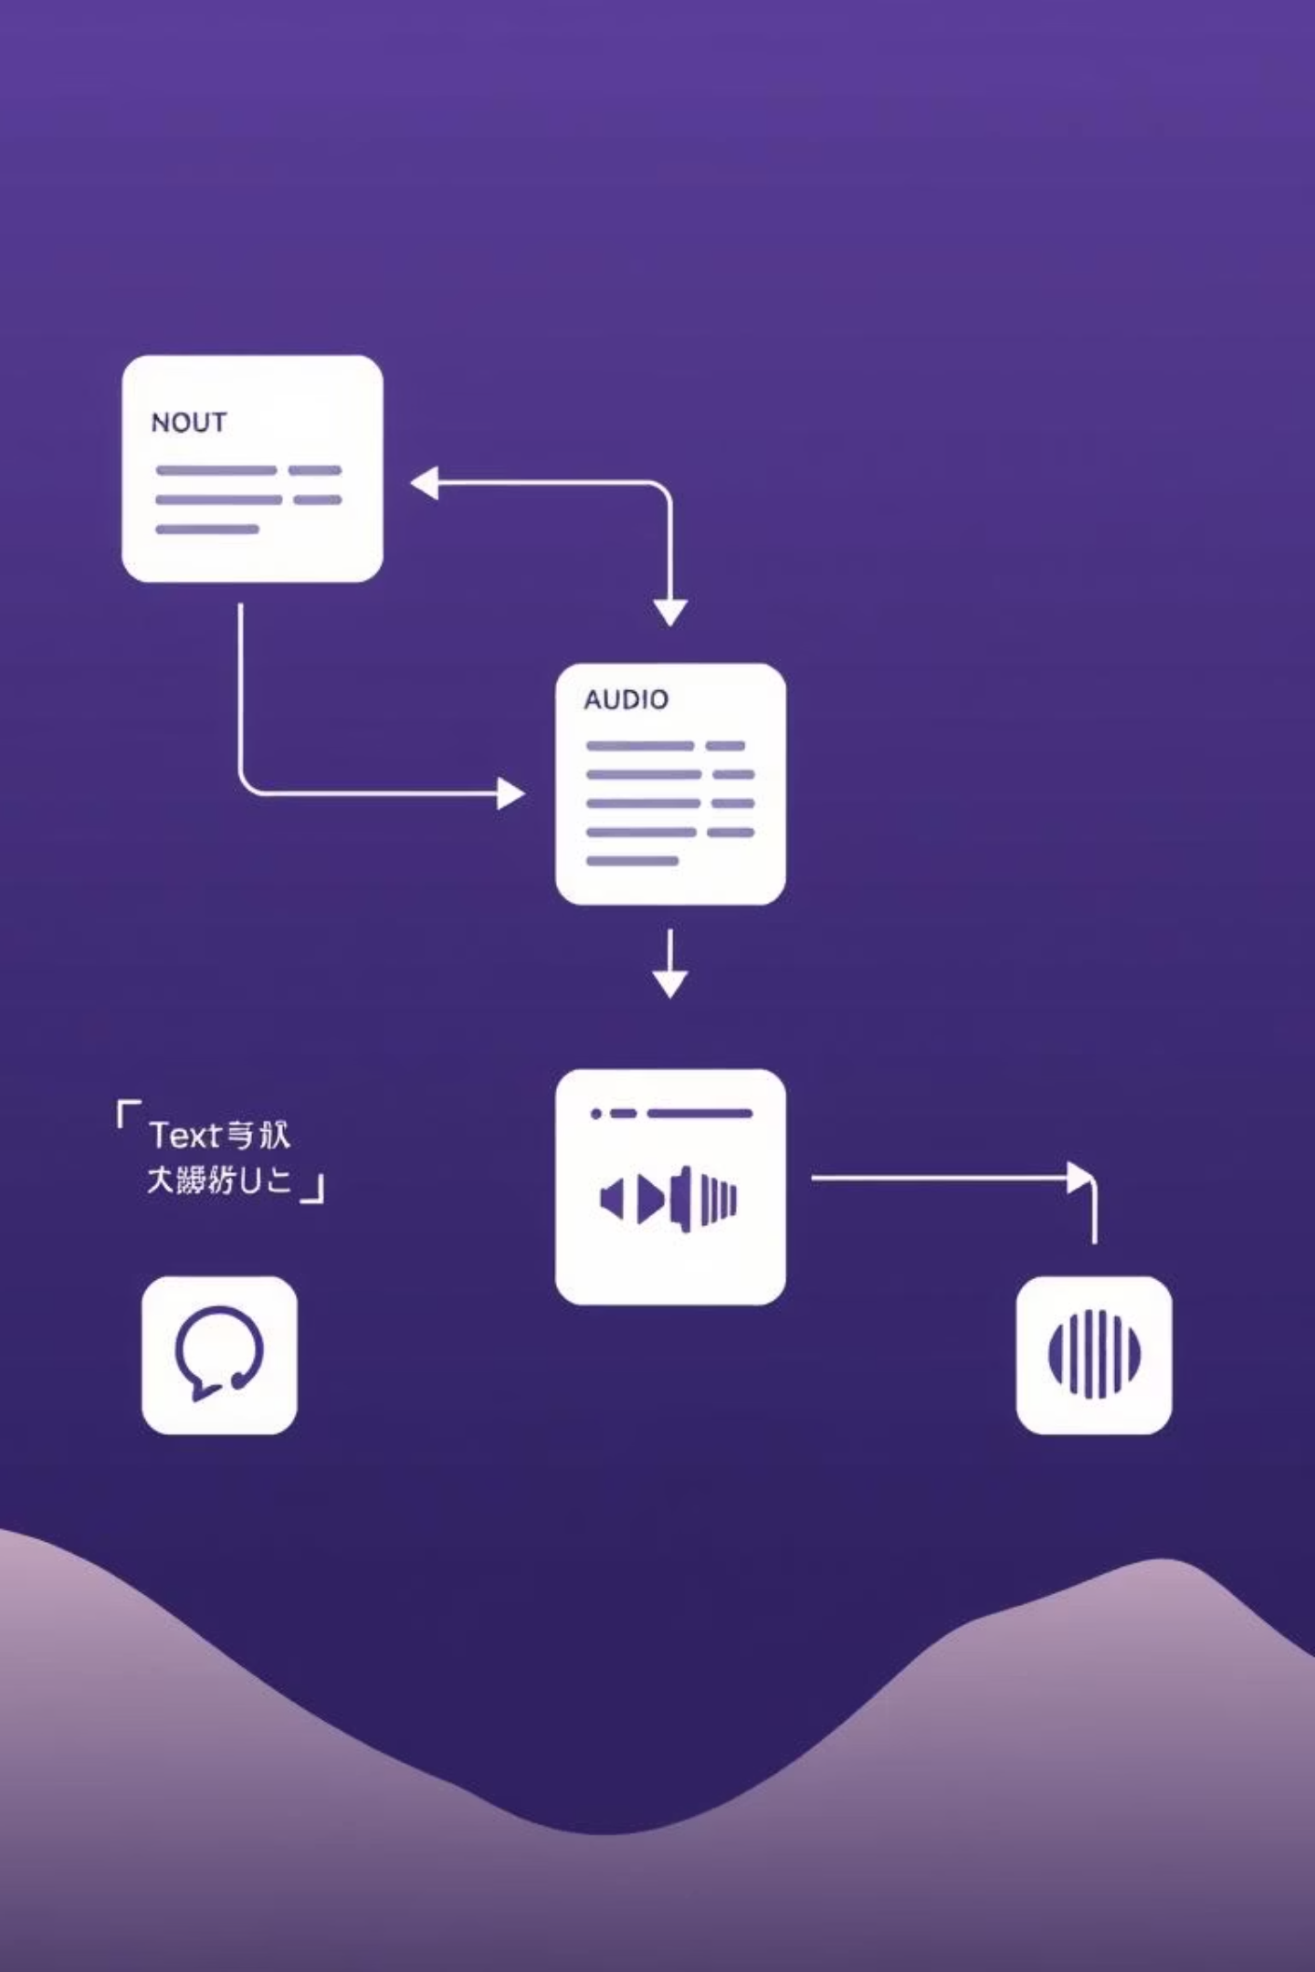
Architecture: The Role of IBM Granite
The text is rewritten using the IBM Watsonx Granite large language model. Prompt chaining is used to ensure the tone-specific rewrite remains faithful to the original meaning while enhancing stylistic quality.

Slide 5
How EchoVerse Works
01
02
03
User Provides Text
Content Display
Tone Selection
Users can paste text directly or upload .txt files into the EchoVerse interface.
The original text content is displayed within the EchoVerse interface for user review.
Users select their desired tone: Neutral, Suspenseful, or Inspiring.
04
05
AI Rewriting
Audio Generation
The IBM Watsonx Granite large language model rewrites the text based on the selected tone.
The rewritten text is transformed into natural-sounding, downloadable audio content.
Witness innovation echo back at you : Watch EchoVerse Working Model (crtl+click this link)

Slide 6




Future Scope of EchoVerse
More Voice Options
Multi-Language Support
Expanding the library of natural-sounding voices for greater customization.
Enabling text-to-audio conversion in various languages.
Advanced Customization
Cloud Integration
Introducing finer controls over narration speed, pauses, and emotional nuances.
Seamless integration with cloud storage services for easier access and sharing.

Slide 7
Conclusion
EchoVerse provides an innovative solution for transforming written content into dynamic audiobooks, enhancing accessibility and usability for a diverse range of users. By leveraging advanced AI models like IBM Watsonx Granite, EchoVerse ensures high-quality, expressive narrations that remain faithful to the original meaning while offering stylistic flexibility. This tool is poised to revolutionize how we consume and interact with written information.
Thank you for your attention!

